Slide 1
Hamilton cycles in highly symmetric graphs
Torsten Mütze
(based on joint papers with Sven Jäger, Petr Gregor, Jerri Nummenpalo, Joe Sawada, Christoph Standke, Pascal Su, Bartosz Walczak, Veit Wiechert, Kaja Wille)

Slide 2
Hamilton cycles
Problem: Given a graph, does it have a Hamilton cycle?
fundamental problem with many applications (special case of travelling salesman problem)
computational point of view:
no efficient algorithm known (NP-complete [Karp 72]), i.e. brute-force approach essentially best possible
what about particular families of graphs?

Slide 3
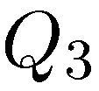
The hypercube
Hypercube
vertices = all {0,1}-sequences (“bitstrings”) of length n
edges = connect bitstrings that differ in exactly one bit
111
101
011
110
001
100
010
000

Slide 4
The hypercube
Hypercube
vertices = all {0,1}-sequences (“bitstrings”) of length n
edges = connect bitstrings that differ in exactly one bit
111
101
011
110
001
100
010
000

Slide 5
The hypercube
Hypercube
vertices = all {0,1}-sequences (“bitstrings”) of length n
edges = connect bitstrings that differ in exactly one bit
111
101
011
110
001
100
010
000

Slide 6
The hypercube
Theorem [Folklore]:
has a Hamilton cycle for every .
Proof: binary reflected Gray code
111
101
011
110
001
100
010
000

Slide 7
The middle layer graph
Consider the cube
11...1
level 3
111
level 2
110
101
011
level 1
100
010
001
level 0
000
00...0
Middle layer graph

Slide 8
The middle layer graph
Consider the cube
11...1
level 3
111
level 2
110
101
011
level 1
100
010
001
level 0
000
00...0
Middle layer graph

Slide 9
The middle layer graph
Middle layer of
11100
11010
11001
10110
10101
10011
01110
01101
01011
00111
11000
10100
10010
10001
01100
01010
01001
00110
00101
00011

Slide 10
The middle levels conjecture
Conjecture:
The middle layer graph has a Hamilton cycle for every .
probably first mentioned in [Havel 83], [Buck, Wiedemann 84]
also (mis)attributed to Dejter, Erdős, Trotter [Kierstead, Trotter 88] and various others
exercise (!!!) in [Knuth 05]

Slide 11
The middle levels conjecture
Conjecture:
The middle layer graph has a Hamilton cycle for every .
Motivation:
Gray codes (applications e.g. in digital communication)
111
111
000
010
001
101
011
110
110
101
011
110
011
111
010
011
110
001
100
010
001
001
100
010
100
101
101
100
000
000

Slide 12
The middle levels conjecture
Conjecture:
The middle layer graph has a Hamilton cycle for every .
Motivation:
Conjecture [Lovász 70]: Every connected vertex-transitive graph has a Hamilton cycle (apart from five exceptions).

Slide 13
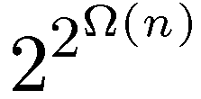
Our results
Theorem 1 [M. 16]:
The middle layer graph has a Hamilton cycle for every .
Theorem 2 [M. 16]:
The middle layer graph has distinct Hamilton cycles.
Remarks:
number of automorphisms is only , so Theorem 2 is not an immediate consequence of Theorem 1

Slide 14
Our results
Theorem 1 [M. 16]:
The middle layer graph has a Hamilton cycle for every .
Theorem 2 [M. 16]:
The middle layer graph has distinct Hamilton cycles.
Remarks:
number of Hamilton cycles is at most , so Theorem 2 is best possible

Slide 15
Our results
Theorem 1 [M. 16]:
The middle layer graph has a Hamilton cycle for every .
Theorem 2 [M. 16]:
The middle layer graph has distinct Hamilton cycles.
Remarks:
we recently found a shorter proof [Gregor, M., Nummenpalo 18] 40 pages → 10 pages
27 lemmas → 2 lemmas
88 formulas → 9 formulas

Slide 16
Proof ideas
Step 1: Build a 2-factor in the graph
2-factor

Slide 17
Proof ideas
Step 1: Build a 2-factor in the graph
Step 2: Connect the cycles in the 2-factor to a single cycle
2-factor
flippable pair

Slide 18
Proof ideas
Step 1: Build a 2-factor in the graph
Step 2: Connect the cycles in the 2-factor to a single cycle
2-factor
flippable pair

Slide 19
Proof ideas
Step 1: Build a 2-factor in the graph
Step 2: Connect the cycles in the 2-factor to a single cycle
The middle layer graph does not have 4-cycles, so we use 6-cycles
2-factor
flippable pair

Slide 20
Proof ideas
Step 1: Build a 2-factor in the graph
Step 2: Connect the cycles in the 2-factor to a single cycle
The middle layer graph does not have 4-cycles, so we use 6-cycles
2-factor
flippable pair

Slide 21
Proof ideas
Step 1: Build a 2-factor in the graph
Step 2: Connect the cycles in the 2-factor to a single cycle
2-factor
Auxiliary graph
1
1
4
3
4
3
2
2
5
8
6
5
8
6
7
7
flippable pairs (disjoint)

Slide 22
Proof ideas
Lemma 1: If is connected, then has a Hamilton cycle.
Lemma 2: If has distinct spanning trees, then has distinct Hamilton cycles.
2-factor
Auxiliary graph
1
1
4
3
4
3
2
2
5
8
6
5
8
6
7
7
flippable pairs (disjoint)

Slide 23
The crucial reduction
Prove that
middle layer graph
has a Hamilton cycle
(many Hamilton cycles)
Prove that
is connected
(has many spanning trees)

Slide 24
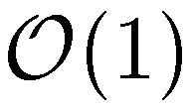
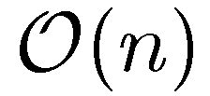
An algorithmic version
Theorem 3 [M., Nummenpalo SODA 17]:
There is an algorithm which for a given vertex of the middle layer graph computes the next one on a Hamilton cycle in time .
Remarks
Initialization time is and required space is
C++ code available on our website
benchmark for , where :
164 days for brute-force search [Shimada, Amano 11]
24 hours reported in [M., Nummenpalo 15]
now: 20 minutes (≈ 5 instructions per generated vertex)
Notes:
What are the constants in the bounds?

Slide 25
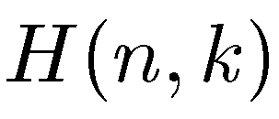
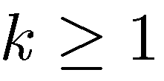
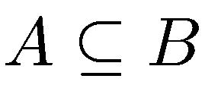
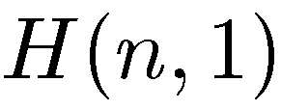
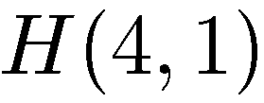
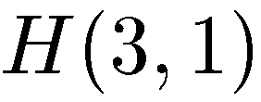
Bipartite Kneser graphs
Integer parameters and
Vertices = all -element and -element subsets of
Edges =
iff
Examples
{2,3,4}
{1,3,4}
{1,2,4}
{1,2,3}
{1,2}
{1,3}
{2,3}
1
{1}
{2}
{3}
{4}
{1}
{2}
{3}

Slide 26
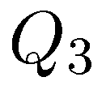
Relation to the cube
3
111
2
110
101
011
1
100
010
001
{1,2}
{1,3}
{2,3}
0
000
is the middle layer graph
{1}
{2}
{3}

Slide 27
Relation to the cube
11...1
3
111
2
110
101
011
1
100
010
001
0
000
00...0

Slide 28
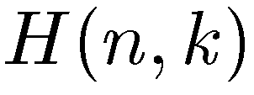
Is hamiltonian?
Conjecture:
For all and the graph has Hamilton cycle.
another instance of Lovász‘ conjecture
raised by [Simpson 91], and Roth (see [Gould 91], [Hurlbert 94])
middle levels conjecture
 | 15 | x | x | x | x | x | x | x
 | 14 | x | x | x | x | x | x
 | 13 | x | x | x | x | x | x
 | 12 | x | x | x | x | x
 | 11 | x | x | x | x | x
 | 10 | x | x | x | x
 | 9 | x | x | x | x
 | 8 | x | x | x
 | 7 | x | x | x
 | 6 | x | x
 | 5 | x | x
 | 4 | x
 | 3 | x
 |  | 1 | 2 | 3 | 4 | 5 | 6 | 7

Slide 29
Is hamiltonian?
Known results:
has a Hamilton cycle if
[Shields, Savage 94]
[Chen 03] (following earlier work by [Simpson 94], [Hurlbert 94], [Chen 00])
???
 | 15 | x | x | x | x | x | x | x
 | 14 | x | x | x | x | x | x
 | 13 | x | x | x | x | x | x
 | 12 | x | x | x | x | x
 | 11 | x | x | x | x | x
 | 10 | x | x | x | x
 | 9 | x | x | x | x
 | 8 | x | x | x
 | 7 | x | x | x
 | 6 | x | x
 | 5 | x | x
 | 4 | x
 | 3 | x
 |  | 1 | 2 | 3 | 4 | 5 | 6 | 7

Slide 30
Our results
Theorem 4 [M., Su 17]:
For all and the graph has Hamilton cycle.
Remark:
simple induction proof, assuming the validity of the middle levels conjecture

Slide 31
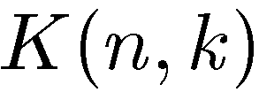
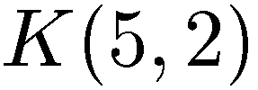
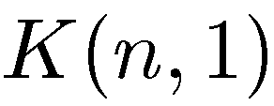
Kneser graphs
Kneser graphs
integer parameters and
vertices = all -element subsets of
edges =
iff
Petersen graph
Complete graph
{1,2}
{1}
{2}
{3,4}
{3,5}
{4,5}
{1,5}
{2,3}
{2,4}
{4}
{3}
{1,4}
{2,5}
{1,3}

Slide 32
Kneser graphs
Kneser graphs
introduced by [Lovász 78] to prove Kneser‘s conjecture, using topological arguments he showed that
stimulated exciting line of research [Bárány 78], [Greene 02], [Ziegler 02], [Matoušek 04]
birth of `topological combinatorics’
Erdős-Ko-Rado-Theorem [Erdős-Ko-Rado 61]:

Slide 33
Kneser graphs
Kneser graphs
have long been conjectured to have Hamilton cycle, with one notable exception, the Petersen graph
another instance of Lovász‘ conjecture

Slide 34
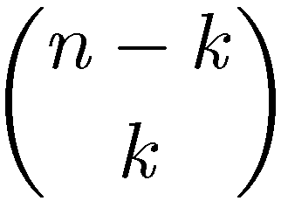
Kneser graphs
Kneser graphs
degree of all vertices is
sparsest and therefore hardest case is when
odd graphs
degree , which is logarithmic in the number of vertices
Observation: Hamiltonicity of implies Hamiltonicity of .

Slide 35
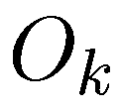
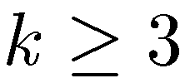
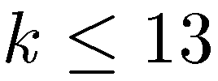
Kneser graphs
Conjecture [Meredith, Lloyd 72], [Biggs 79]: is Hamiltonian for every .
, [Balaban 72]
, [Meredith, Lloyd 72+73]
[Mather 76]
[Shields, Savage 04]
15 | x | x | x | x | x | x | x
14 | x | x | x | x | x | x
13 | x | x | x | x | x | x
12 | x | x | x | x | x
11 | x | x | x | x | x
10 | x | x | x | x
9 | x | x | x | x
8 | x | x | x
7 | x | x | x
6 | x | x
5 | x | P
4 | x
3 | x
 | 1 | 2 | 3 | 4 | 5 | 6 | 7

Slide 36
Kneser graphs
has a Hamilton cycle if
[Heinrich, Wallis 78]
[B. Chen, Lih 87]
[Y. Chen 00], [Y. Chen, Füredi 02]
[Y. Chen 03]
several other partial results [Johnson 04], [Johnson, Kierstead 04], etc.
???
15 | x | x | x | x | x | x | x
14 | x | x | x | x | x | x
13 | x | x | x | x | x | x
12 | x | x | x | x | x
11 | x | x | x | x | x
10 | x | x | x | x
9 | x | x | x | x
8 | x | x | x
7 | x | x | x
6 | x | x
5 | x | P
4 | x
3 | x
 | 1 | 2 | 3 | 4 | 5 | 6 | 7

Slide 37
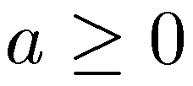
Our results
Theorem 5 [M., Nummenpalo, Walczak STOC 18]:
For all , the odd graph has a Hamilton cycle.
Theorem 6 [M., Nummenpalo, Walczak STOC 18]:
For all and , the graph has a Hamilton cycle.
15 | x | x | x | x | x | x | x
14 | x | x | x | x | x | x
13 | x | x | x | x | x | x
12 | x | x | x | x | x
11 | x | x | x | x | x
10 | x | x | x | x
9 | x | x | x | x
8 | x | x | x
7 | x | x | x
6 | x | x
5 | x | P
4 | x
3 | x
 | 1 | 2 | 3 | 4 | 5 | 6 | 7

Slide 38
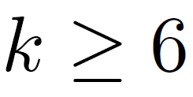
Our results
Theorem 5 [M., Nummenpalo, Walczak STOC 18]:
For all , the odd graph has a Hamilton cycle.
Theorem 6 [M., Nummenpalo, Walczak STOC 18]:
For all and , the graph has a Hamilton cycle.
Theorem 7 [M., Nummenpalo, Walczak STOC 18]:
For all , the odd graph has at least distinct Hamilton cycles.

Slide 39
Proof ideas
Step 1: Build a 2-factor in the graph
based on Dyck words of length [M., Standke, Wiechert 17]
all cycles have the same length
number of cycles = th Catalan number

Slide 40
Proof ideas
Step 1: Build a 2-factor in the graph
Step 2: Connect the cycles in the 2-factor to a single cycle
flippable triple
flipping 6-cycle

Slide 41
Proof ideas
Step 1: Build a 2-factor in the graph
Step 2: Connect the cycles in the 2-factor to a single cycle
Reduces the problem to a spanning tree problem in a hypergraph
auxiliary hypergraph
2
2
1
1
5
4
4
5
3
3
7
7
6
6

Slide 42
Central levels problem
Conjecture:
has a Hamilton cycle through the
middle levels for all and .
raised by [Savage 93], [Gregor, Škrekovski 10] , [Shen, Williams 15]
known cases of the `central levels problem‘:
[Gray 53]
[El-Hashash, Hassan 01], [Locke, Stong 03]
[Gregor, Škrekovski 10]
???
[M. 16]

Slide 43
Central levels problem
Theorem 8 [Jäger, Gregor, M., Sawada, Wille ICALP 18]:
has a Hamilton cycle through the middle four levels
( ) for all .
Theorem 9 [Jäger, Gregor, M., Sawada, Wille ICALP 18]:
has a 2-factor through the middle levels
for all and .

Slide 44
Central levels problem
Theorem 9 [Jäger, Gregor, M., Sawada, Wille ICALP 18]:
has a 2-factor through the middle levels
for all and .

Slide 45
Central levels problem
Theorem 9 [Jäger, Gregor, M., Sawada, Wille ICALP 18]:
has a 2-factor through the middle levels
for all and .
Proof:
Symmetric chain decomposition (SCD)
consider two edge-disjoint SCDs (they exist by [Shearer Kleitman 79])
all chains have odd length, even after restricting to middle levels

Slide 46
Central levels problem
Theorem 9 [Jäger, Gregor, M., Sawada, Wille ICALP 18]:
has a 2-factor through the middle levels
for all and .
Proof:
Symmetric chain decomposition (SCD)
consider two edge-disjoint SCDs (they exist by [Shearer Kleitman 79])
all chains have odd length, even after restricting to middle levels
taking every second edge yields two edge-disjoint perfect matchings
their union is a 2-factor

Slide 47
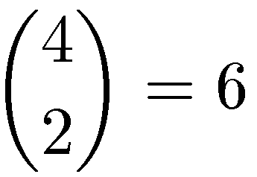
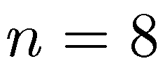
Edge-disjoint SCDs
Theorem 10 [Jäger, Gregor, M., Sawada, Wille ICALP 18]:
has four edge-disjoint SCDs for all .
this yields different cycle factors
Can we join one of them to a Hamilton cycle?
we conjecture that has edge-disjoint SCDs
first open case is (five SCDs), would cover infinitely many cases (all multiples of 8)

Slide 48
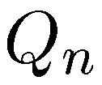
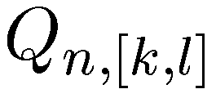
A sweeping generalization
Problem: For any given interval , does the subgraph of between levels and have a Hamilton cycle?
and : entire cube
Special cases:
: central levels problem
level
level

Slide 49
A sweeping generalization
Problem: For any given interval , does the subgraph of between levels and have a Hamilton cycle?
Partition classes have same size only if and or if is odd and
Two more general notions:
Saturating cycle := all vertices in the smaller partition class are visited
Tight enumeration := only distance-2 steps in the bigger partition class
total length/distance =
total length = total distance =

Slide 50
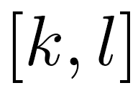
A sweeping generalization
Problem: For any given interval , does the subgraph of between levels and have a Hamilton cycle?
Q1: For which does have a saturating cycle?
Q2: For which does have a tight enumeration?
Two weaker notions:
Saturating cycle := all vertices in the smaller partition class are visited
Tight enumeration := only distance-2 steps in the bigger partition class
total length/distance =
total length = total distance =

Slide 51
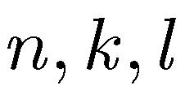
Our results
[Gregor, M. STACS 17]: Positive answers for all parameters except for central levels problem
Q1: For which does have a saturating cycle?
Q2: For which does have a tight enumeration?
we also provide corresponding constant-time generation algorithms

Slide 52
Combinatorial Object Server++
website first launched by Frank Ruskey (University of Victoria)
goal: explore/run combinatorial algorithms
relaunched in 2018 with Joe Sawada (University of Guelph) and Aaron Williams (Bard College), two of Frank‘s former students
currently: http://page.math.tu-berlin.de/~muetze/cos

Slide 53
Open problem 1
Conjecture:
For all and the Kneser graph graph
has a Hamilton cycle, except .
known cases:
dense Kneser graphs:
sparse Kneser graphs: ,
{1,2}
first open case is
{3,4}
{3,5}
{4,5}
{1,5}
{2,3}
{1,4}
{2,4}
{2,5}
{1,3}

Slide 54
Open problem 2
Conjecture:
has a Hamilton cycle through the
middle levels for all and .
known cases:
first open case is (middle six levels)

Slide 55
Open problem 3
Conjecture:
has edge-disjoint symmetric chain decompositions
for all .
true for
first open case is (five SCDs)

Slide 56
Thank you!

